Slide 1

MASc Thesis: GTHA housing market analysis performed on Teranet dataset EDA of augmented Teranet dataset: price time series and count of records per pin and x y coordinate
Meeting of 21-Jun-2019
Prepared by: Stepan Oskin
Photo by mwangi gatheca on Unsplash

Slide 2
Contents
Recap of the previous meeting
New features in Teranet dataset
Exploratory Data Analysis of the new features:
Aim of the analysis
Number of records per `pin` and `xy`
Price and rolling sum time series per `pin` and `xy`
Future work direction
GitHub repository link

Slide 3
Section 0: Recap of the previous meeting
(was on 24-May-2019)

Slide 4

0. Recap of the previous meeting
Need more features in Teranet dataset: to filter records and perform meaningful analysis / modeling
One approach: connect other geo-referenced data sources (i.e., land use zoning information)
Alternative approach: infer as much structure from the data as possible
Teranet records posses a wealth of information about the housing market and its dynamics that can be revealed via simple data manipulations
?

Slide 5
0. Recap of the previous meeting
Can't cluster points directly from Teranet
Very large number of records (75k-150k records per year for GTHA)
only 1 feature (consideration_amt)
pins, coordinates, addresses are useless for clustering neighbourhoods and sub-markets
hard to convert point data to time series
If grouped by point, only few points would have enough records
If grouped by buffer, what buffer size defines similarity?
Need more features (make points “aware” of their surroundings)
Produce aggregates from Teranet records to “infuse” DAs
Group Teranet subset by DA and join to DA geometry
Focus of the previous
presentation

Slide 6
0. Wrong assumptions
Can't cluster points directly from Teranet
Very large number of records (75k-150k records per year for GTHA)
only 1 feature (consideration_amt)
pins, coordinates, addresses are useless for clustering neighbourhoods and sub-markets
hard to convert point data to time series
If grouped by point, only few points would have enough records
If grouped by buffer, what buffer size defines similarity?
Need more features (make points “aware” of their surroundings)
New features prove old assumptions wrong.

Slide 7
Section 1: New features introduced to Teranet dataset

Slide 8
1. New features in Teranet: data sources
Cleaned Teranet data with `da_id` column
`da_id` is renamed from `OBJECTID`
Produced via a spatial join of Teranet points with DA geometry (same as above)
HHSaleHistory_cleaned_v0.9_GTHA_DA.csv
Cleaned and filtered for duplicates
`consideration_amt`<$30 reset to NaN
813’138 duplicate entries were removed
Filtered to include only GTHA via a spatial join
`da_id` column with ID of corresponding Dissemination Area added via a spatial join
6’062’853 records remaining (4’637’584 records with non-null `consideration_amt`

Slide 9
1. New features in Teranet: new columns
New columns added (available on transaction level in original Teranet dataset):
da_id, da_city, da_median_tot_inc: were added during the spatial join with DA data
xy: x and y concatenated together (used for grouping by coordinate pairs)
pin/xy_total_sales: total records for this pin/xy
pin/xy_prev_sales: previous records from this pin/xy (not counting current transaction)
pin/xy_price_cum_sum: cumulative price of all records to date from this pin/xy
pin/xy_price_pct_change: price percentage change compared to previous record from this pin/xy
price_da_pct_change: price percentage change compared to previous record from this DA (by da_id)
pin/xy_years_since_last_sale: years since last sale from this pin/xy
da_days/years_since_last_sale: days or years since last sale from this DA (by da_id)
pin/xy_sale_next_1y/3y: whether this pin or xy will have another sale in the future
sale_next_6m/1y/3y: "looks into the future" to see whether there is another transaction from this pin/xy within the given time horizon (6 months, 1 year, 3 years)

Slide 10
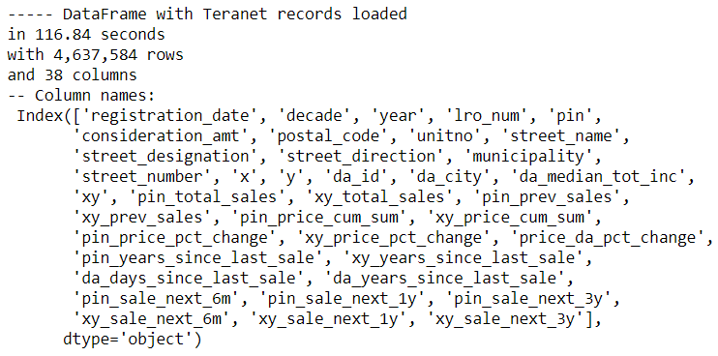
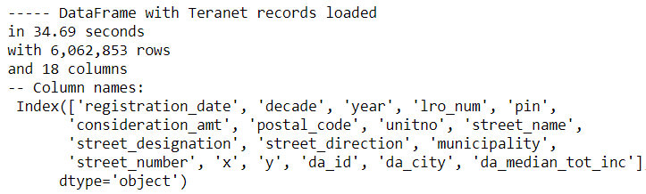
1. New features in Teranet: new columns
New
Old
HHSaleHistory_cleaned_v0.9_GTHA_DA_with_cols_v0.9.csv
HHSaleHistory_cleaned_v0.9_GTHA_DA.csv

Slide 11
Section 2: Exploratory Data Analysis (EDA) of the new features

Slide 12
2. EDA of the new features: aim of the analysis
Assess reliability of the new features
Investigate how records group by pin and xy
Assess suitability of new features in identification of submarkets / property type for transactions (potential for clustering)

Slide 13
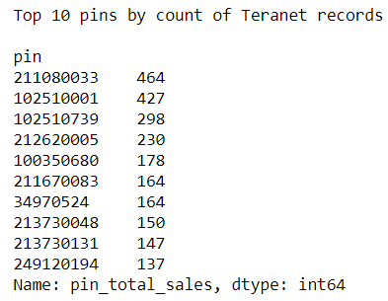
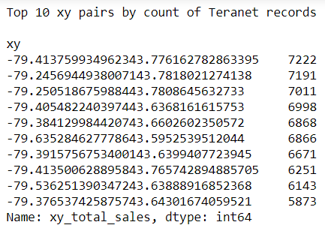
2. EDA: number of records by pin and xy
significantly more records with unique `pin` compared to unique `xy` coordinate pairs
appears to be reasonable
some `xy` coordinate pairs correspond to records with different pins, (e.g., condo complexes)
some condo complexes are recorded under the same pin (top pins by count of records)

Slide 14
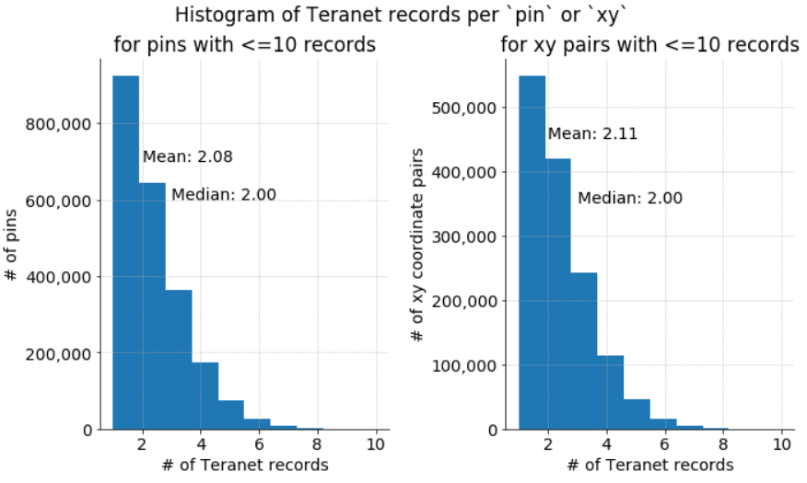
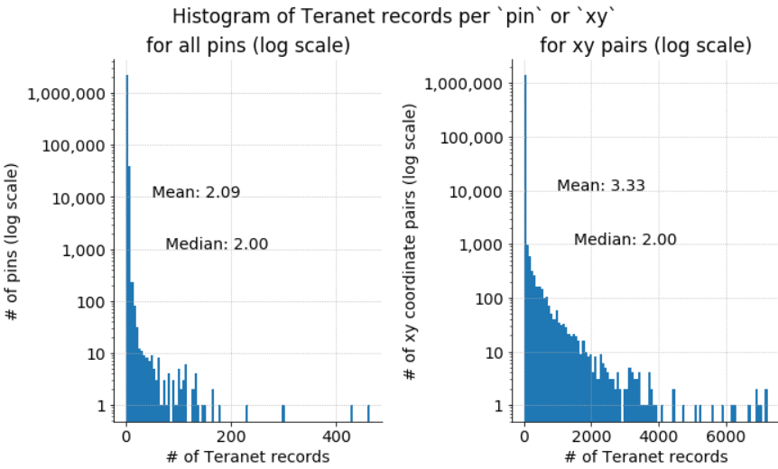
2. EDA: number of records by pin and xy
There is a clear break in distribution of counts by both pin and xy

Slide 15
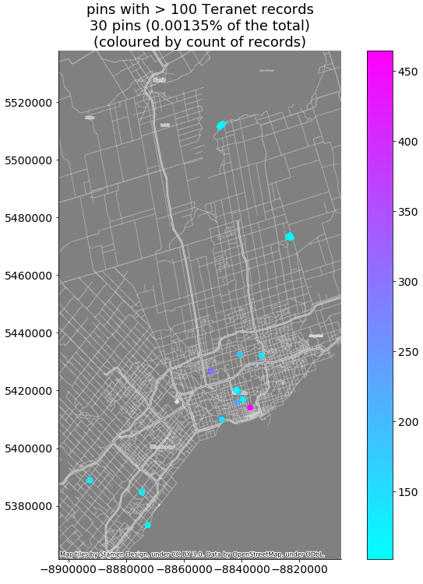
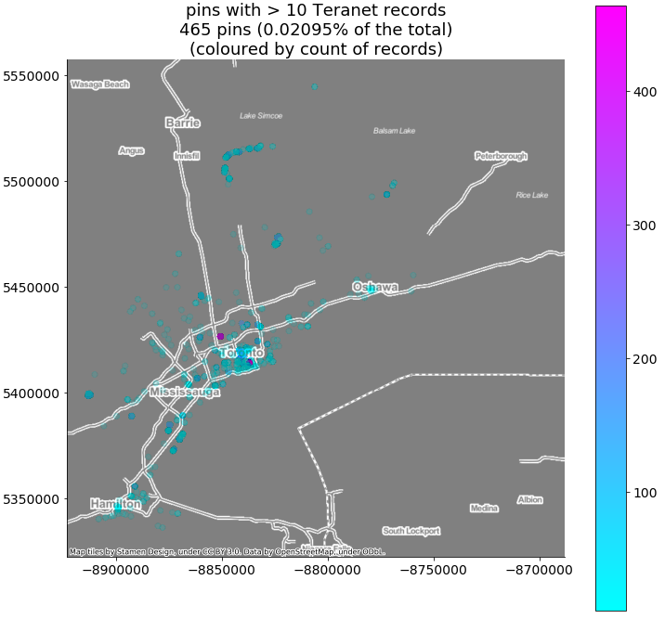

Slide 16
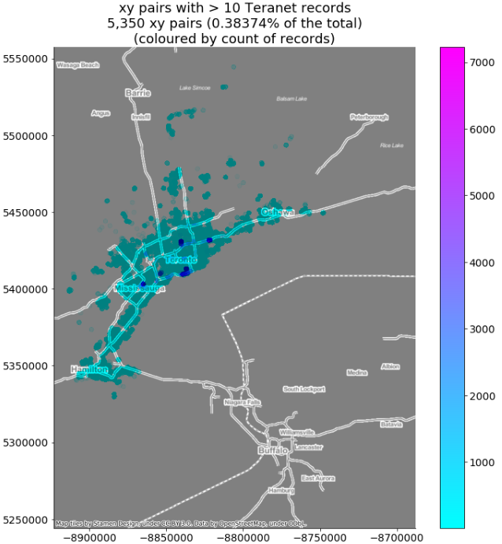
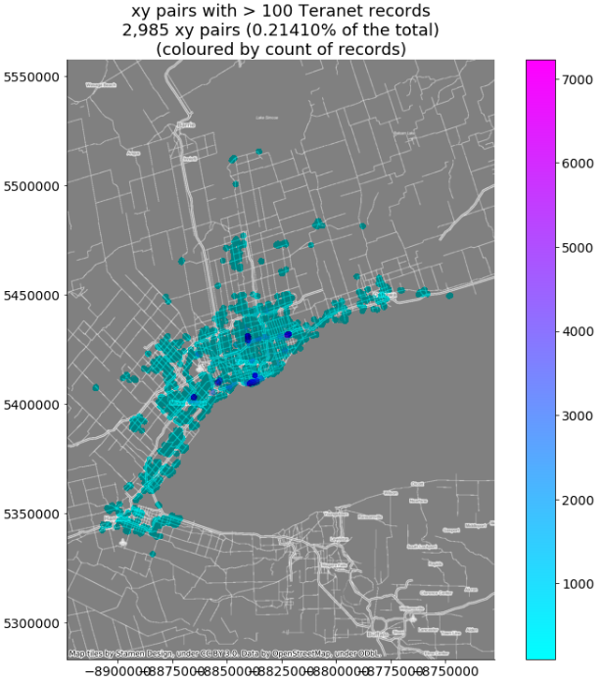

Slide 17
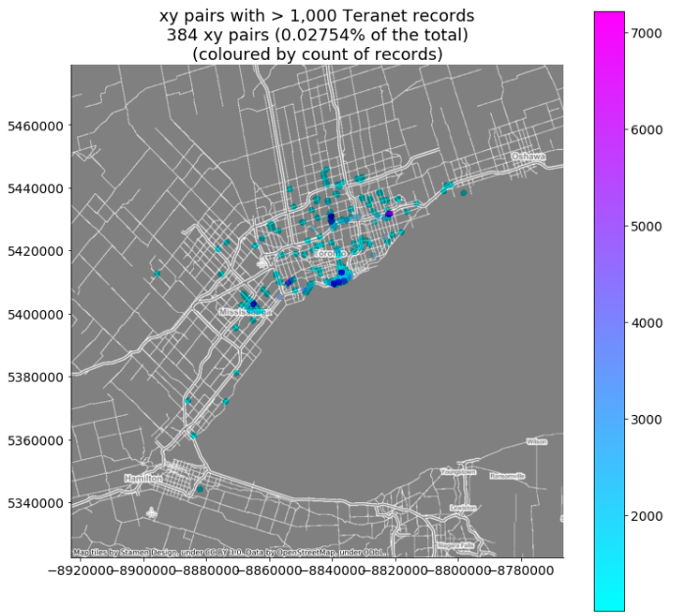
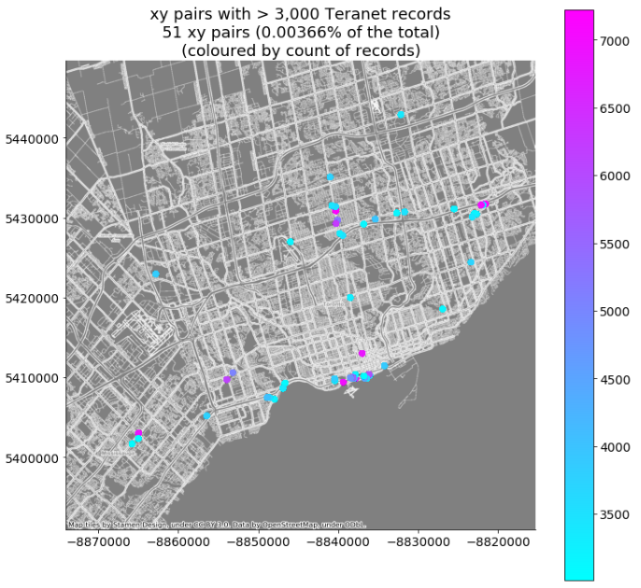

Slide 18
Top pins: condo and apartment complexes

Slide 19
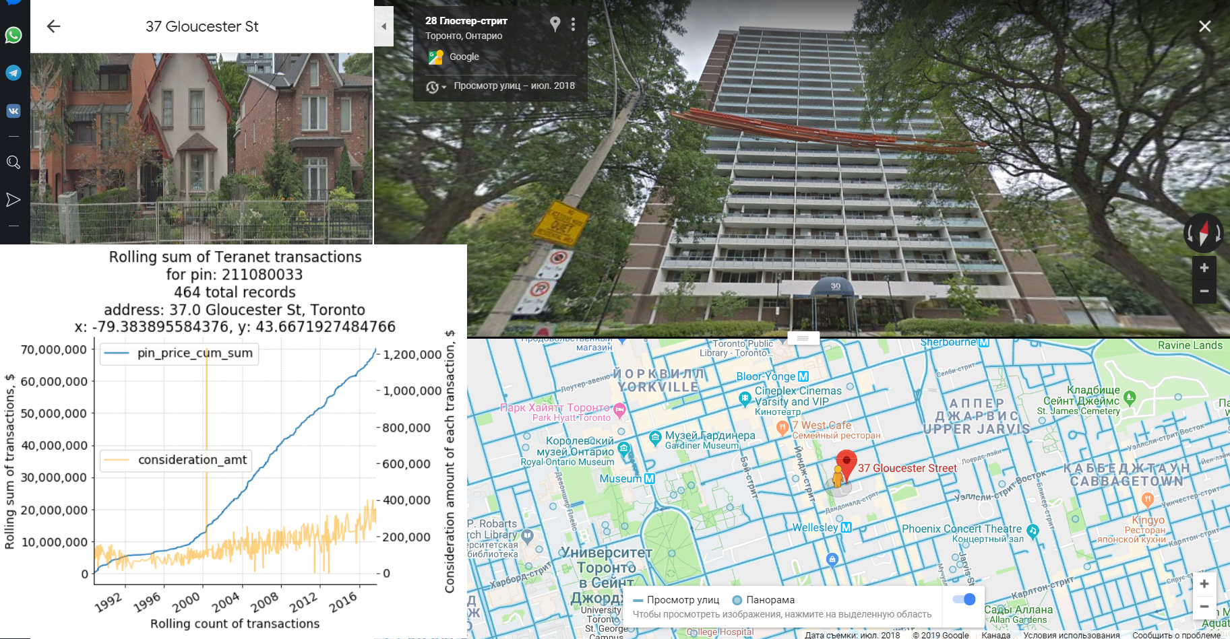
EDA: top pins

Slide 20
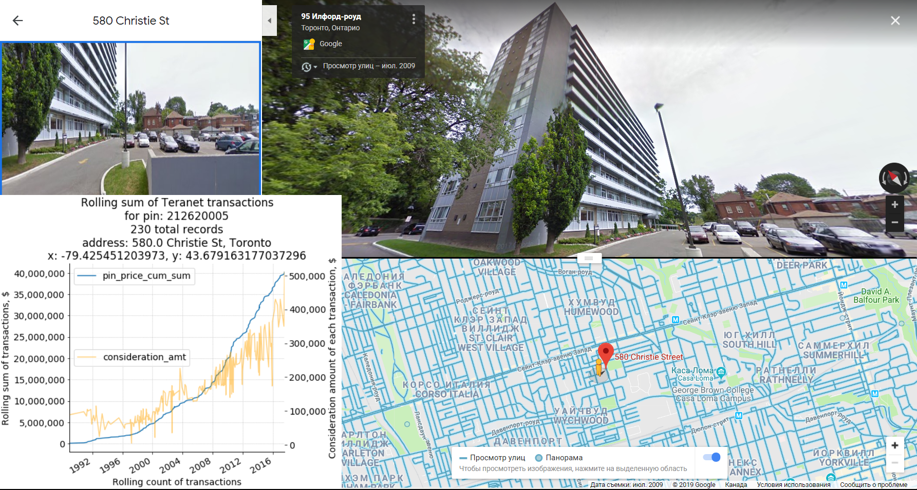
EDA: top pins

Slide 21
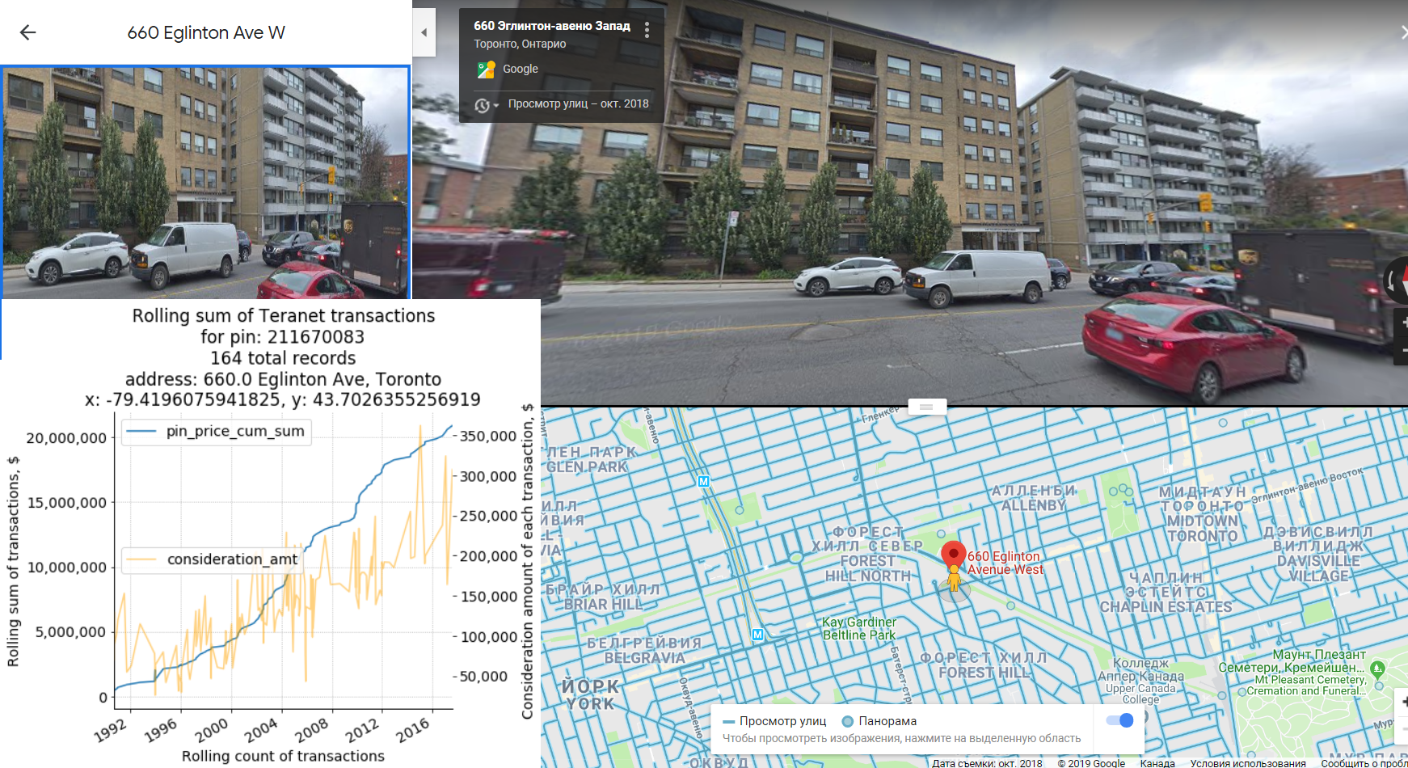
EDA: top pins

Slide 22
Top pins: multiple properties under same pin

Slide 23
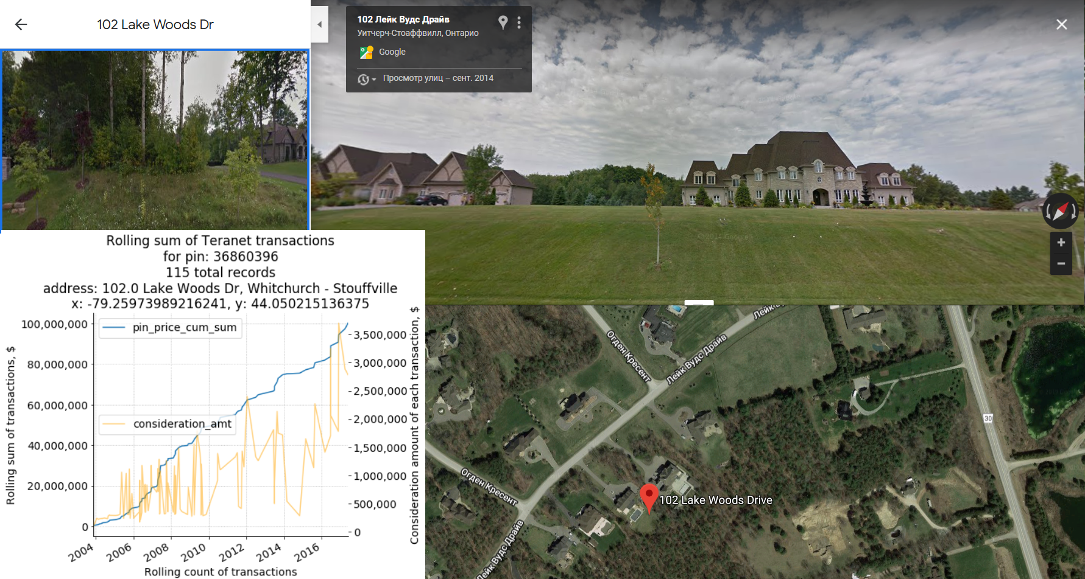
EDA: top pins

Slide 24
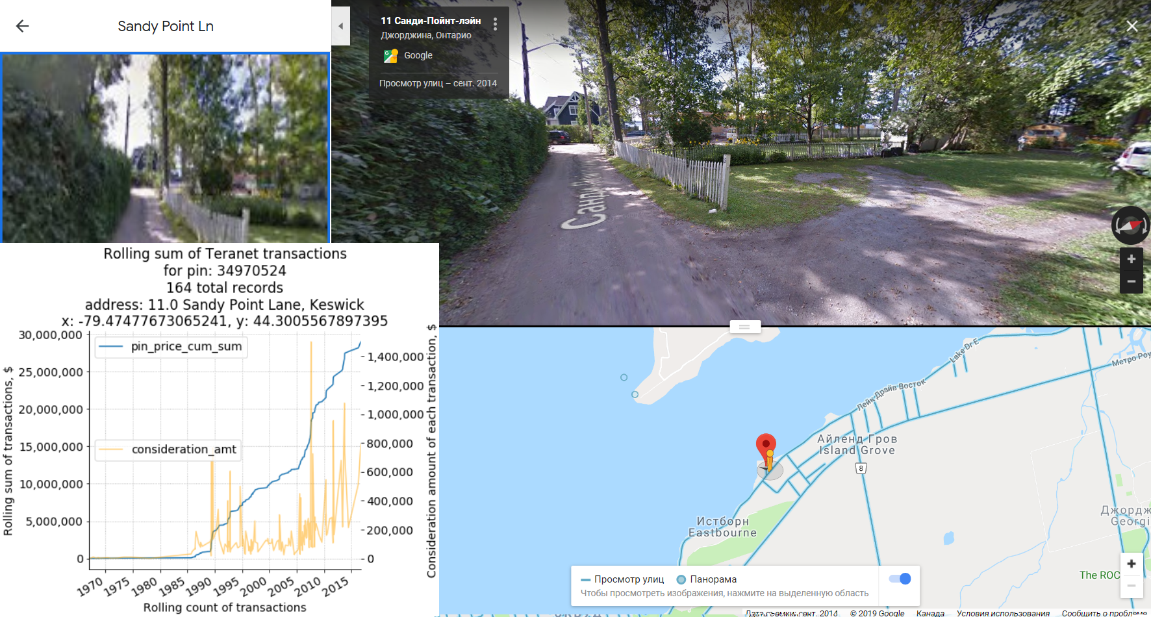
EDA: top pins

Slide 25
Top pins: duplicate records

Slide 26
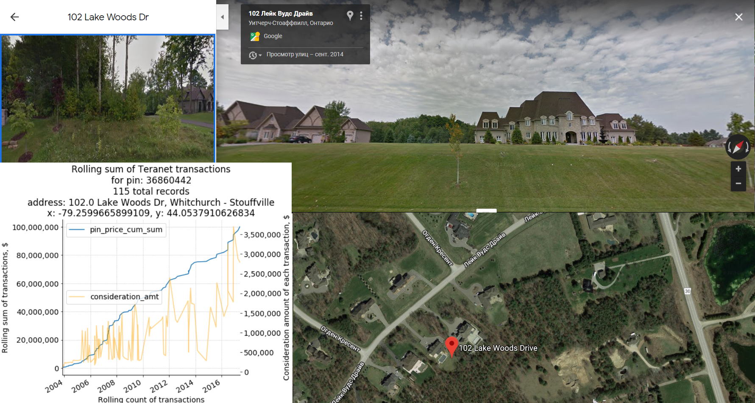
EDA: duplicates

Slide 27

EDA: duplicates

Slide 28
Top xy pairs: large condo complexes (hi-rises)

Slide 29
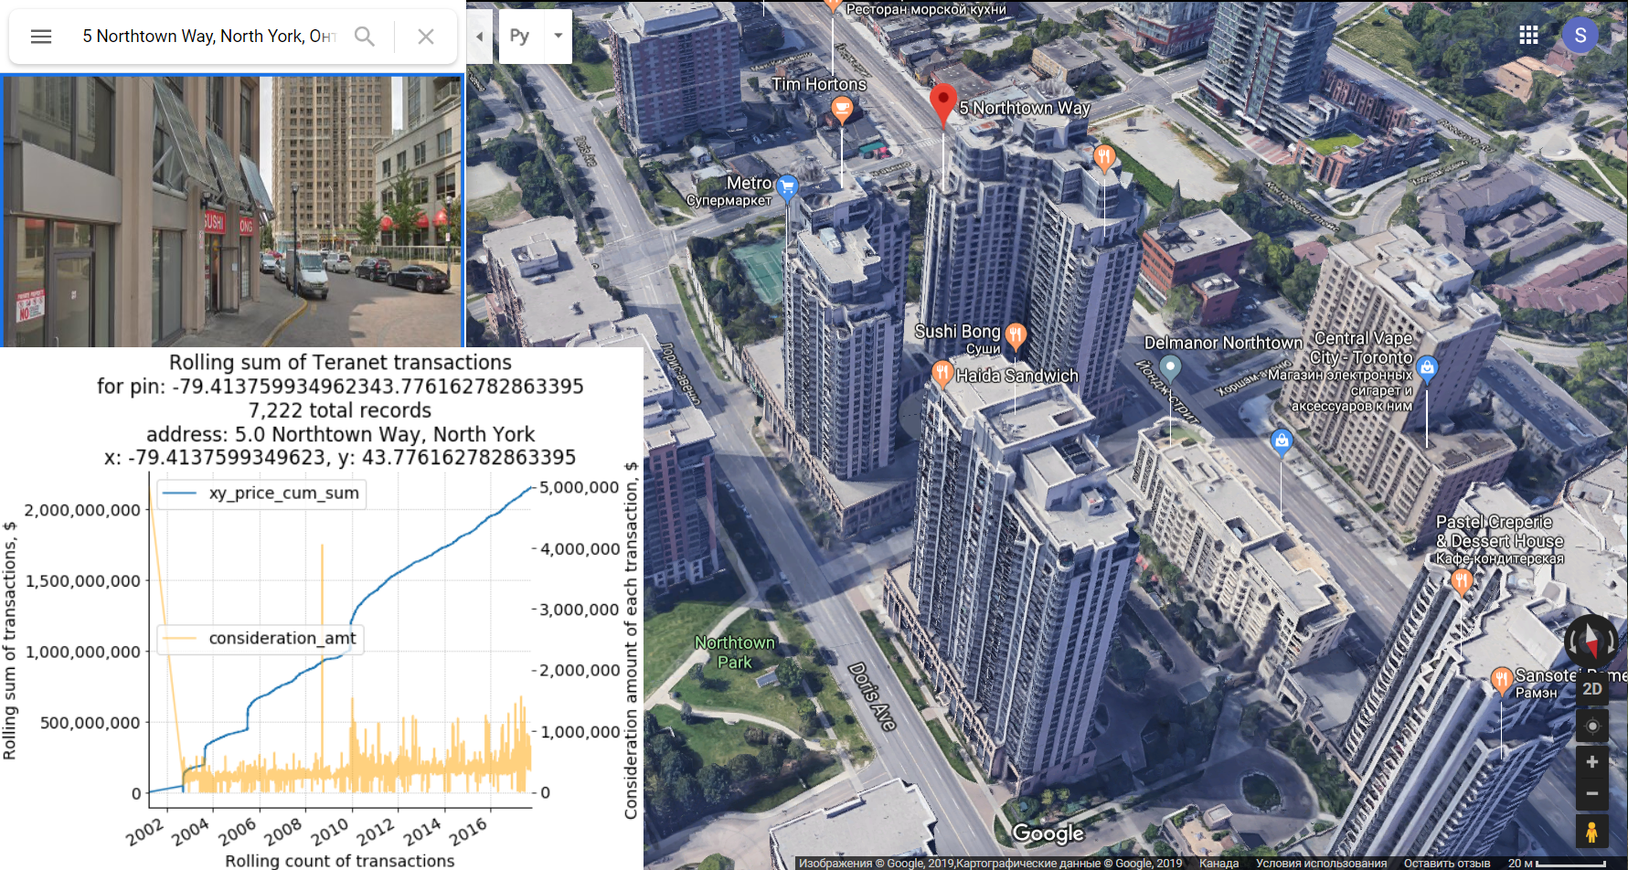
EDA: top xy

Slide 30
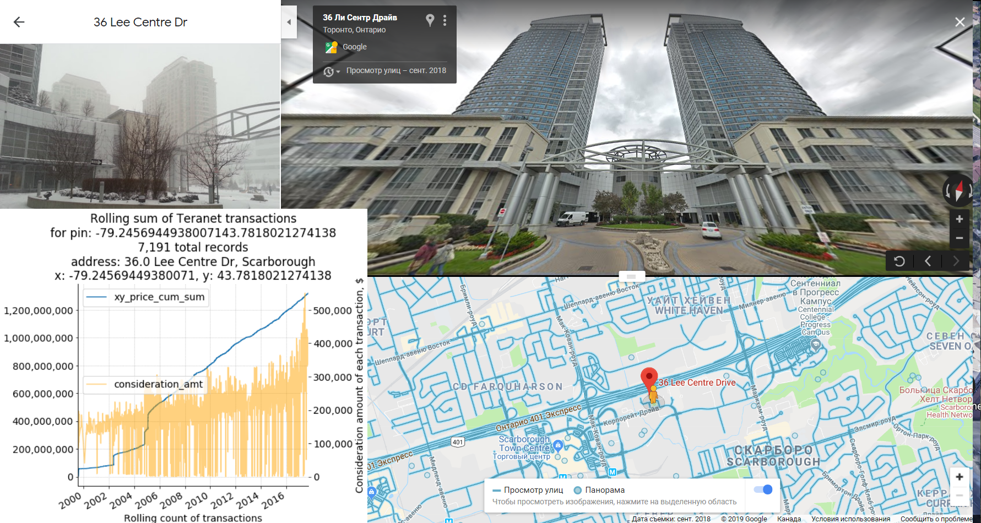
EDA: top xy

Slide 31
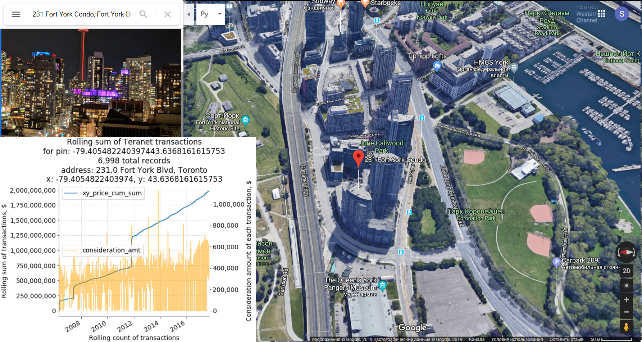
EDA: top xy

Slide 32
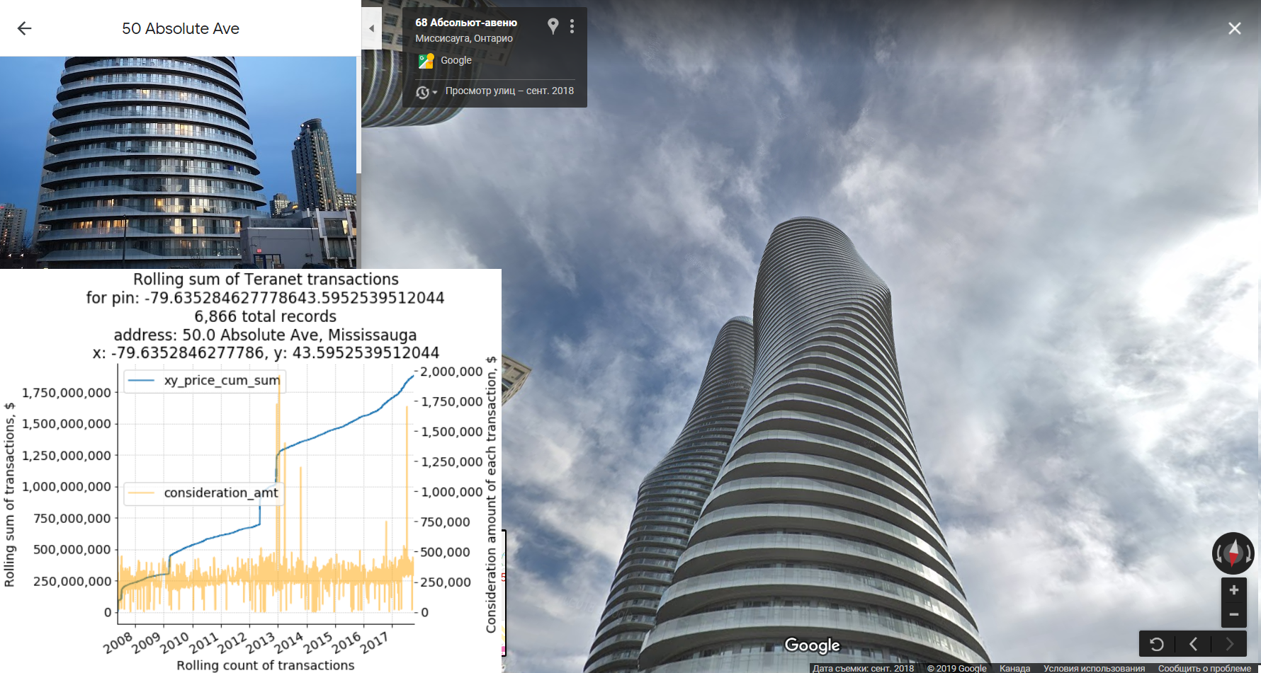
EDA: top xy

Slide 33
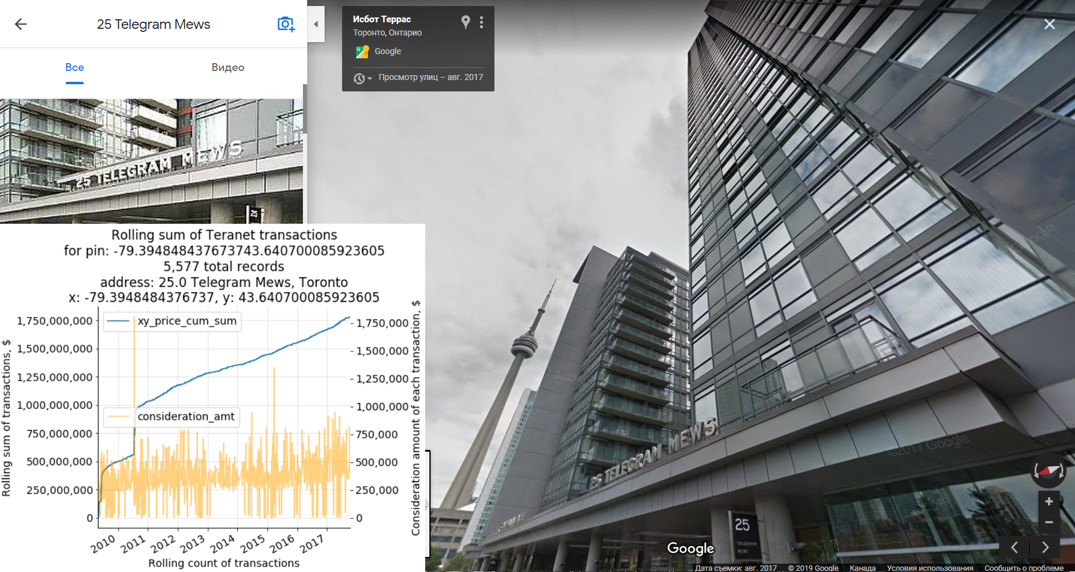
EDA: top xy

Slide 34
3. Future work directions

Slide 35
3. Possible future work directions
Focus on analytics / visualization: Produce dynamic maps / 3D mesh surfaces / simple phase diagrams. Aim to reveal different dynamics of GTHA housing market via visuals (data mining).
Focus on unsupervised machine learning: Try to use the best feature extraction / unsupervised machine learning techniques to infer as much structure from the housing market data as possible. Aim to produce neighbourhood maps via housing market dynamics.
Focus on time series analysis / prediction / supervised machine learning: extract a target variable from the dataset, build a predictive model based on housing market data
Focus on hypothesis testing: Establish a hypothesis (e.g., commodification of housing), use housing market data to test it.
Focus on bridging modelling and data science: Find an aspect of housing market for which an AnyLogic model can be produced, use Teranet data to calibrate / assess accuracy. Aim to combine deterministic modelling with empirical data science methods.
(Additional thought / side project): construct a convenient, efficient, and powerful database based on Teranet data that can be accessed by a broad group of researchers via a variety of APIs. Aim to streamline future research efforts.

Slide 36
4. GitHub repository link

Slide 37
4. GitHub repository link
Data cleanup:
https://github.com/stepan-o/geo/blob/master/notebooks/data_cleaning/Teranet_data_cleaning.ipynb
Spatial join with GTHA DA geometry:
https://github.com/stepan-o/geo/blob/master/notebooks/data_cleaning/Teranet_GTHA_DA_spatial_join.ipynb
Feature extraction:
https://github.com/stepan-o/geo/blob/master/notebooks/feature_extraction/Teranet_feature_extraction.ipynb
EDA of new features (contents of this presentation):
https://github.com/stepan-o/geo/blob/master/notebooks/EDA/Teranet_new_cols_EDA.ipynb

